Slide 1
ELL Paraeducator
Staff Binder
Prepared for Diana Schroeder
Compiled by Roanna Parker

Slide 2
Table of Contents
Section 1
School Information
List of Colleagues
Administration Help
Section 2
Confidentiality
Professionalism
Evaluations
Communication
Section 3
Classroom Information
Student Information:
Goals, Accommodation and Behavior
Schedules

Slide 3
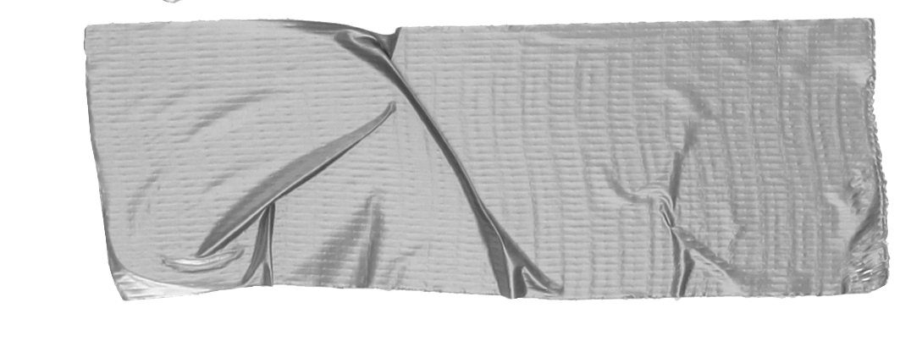
School Information
List of Colleagues
Administration Help
Section 1

Slide 4
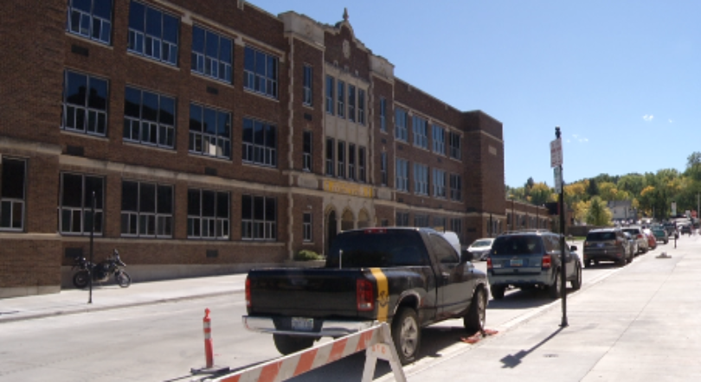
Main Entrance
Tip
Parking is difficult downtown. Street parking is limited to 2 hours.
Park in the staff parking lot on the North side.
Enter the building on the West side, 3rd Ave. The secretary’s office is immediately inside these doors.

Slide 5
SSchool InformationSc
Office Hours: 7:30 a.m. - 4:00 p.m.
Administration Office: 701-857-4660
Principal: Keith Altendorf
If you will be absent due to illness, contact me via text: 701-555-5555

Slide 6
Your Colleagues.
Diana Schroeder, English Language Teacher (EL)
Chelsey Durr , Learning Disabilities Teacher (LD)
Melissa Frederick, Emotional Disabilities Teacher (ED)
Kia Moch, Speech Language Pathologist (SLP)
Heidi Roberts, School Counselor
Tami Spiros, School Counselor
Eric Steele, ED/ LD Strategist
Vickie Stutter , LD
Use your First Class email account to connect with a teacher

Slide 7
Administration Help
If you lose your badge: Get a temporary one from the school secretary. Then call HR or put in a request via email to replace your badge. If you know it is not sitting at home please report it immediately so that it cannot be used by anyone else.
If you did not receive a paycheck or need to change information on your paycheck: Contact the administration building downtown. The number is: 701-857-4400, ask for Sarah. See the next page to find the link to see your paycheck online.
Cafeteria / Library: The number ID that was given to you will allow you to check out books from the library and also pay for your meal in the cafeteria.

Slide 8
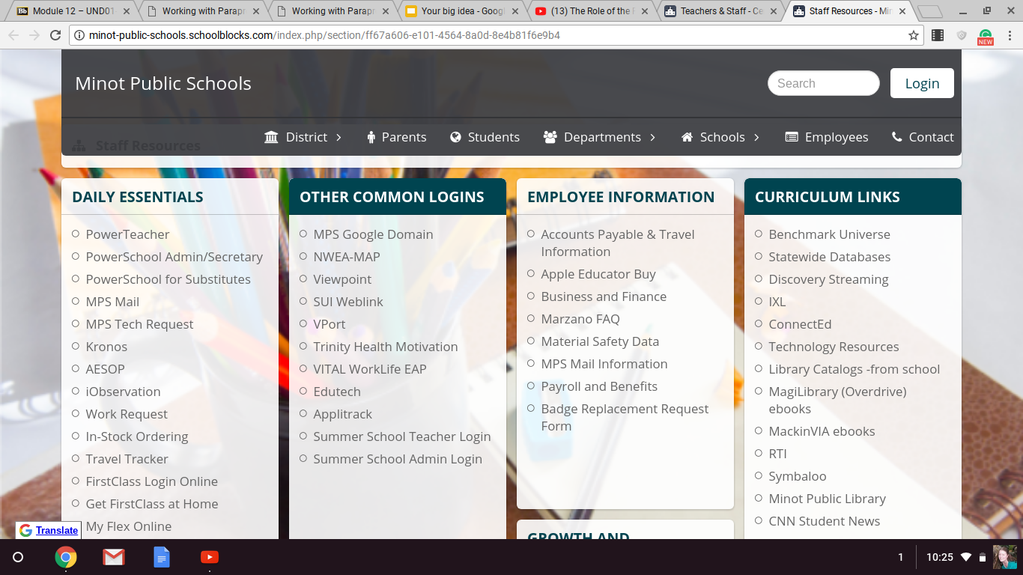
Click this link to see your paychecks

Slide 9
Confidentiality
Professionalism
Evaluations
Communication
Section 2

Slide 10
Confidentiality
FERPA: Family Educational Rights and Privacy Act
View the below video to get an idea about FERPA.
Tip
There will always be someone in the school that chooses to talk about things that should be confidential. Don’t be that person.

Slide 11
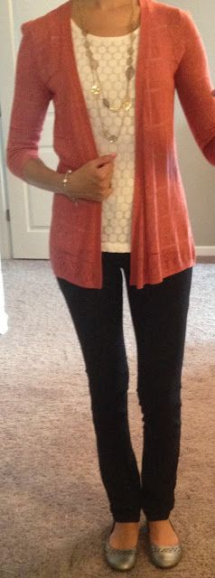
Professionalism.
Not knowing what is ok to wear can be frustrating. This information is not given to have you buy a new wardrobe, but merely as a guildeline.
Do:
Be comfortable
Be modest
Be aware of coffee or smoker’s breath
Watch for emails that indicate special dress days, Christmas, School Spirit etc
Avoid:
Holes in clothing
Anything that shows cleavage, sitting or bending over
Smells, good or bad, including perfume
Story for illustration purposes only

Slide 12
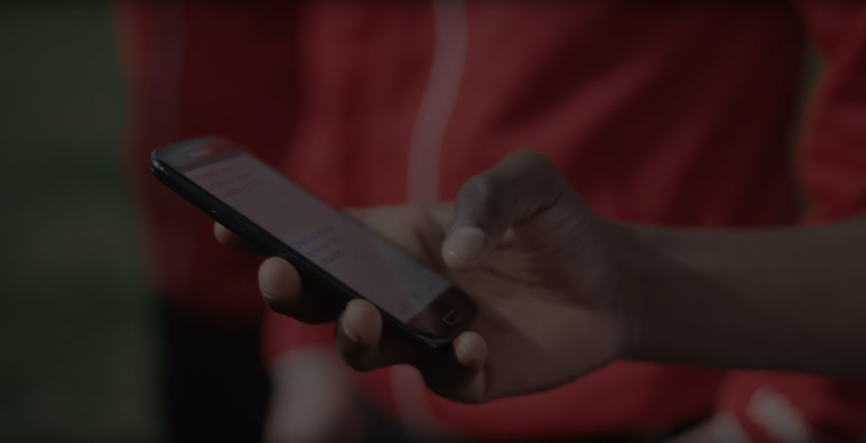
Evaluations
I believe evaluations are for recording purposes only.
As a teacher I hope that you will know throughout your time by communication from me how you are doing. If you have questions about your performance please set up a time to talk with me. I value your work with our students.
Evaluations will be conducted once a year in the spring.

Slide 13
Difficult Situations
If you encounter a situation with a staff member, keep in mind that we are all working toward the success of the student. Sometimes we have different perspectives. Follow what the teacher is asking and write me an email if you feel you need more support in that class.
Communication
Daily communication: Contact me via email or text
Concerns? : Give me a little advance so that I can set aside some time for us to sit and talk without distractions.
My goal: Once a month I will schedule a time for a para group meeting for collaborating, problem solving and encouragement.

Slide 14
Class Schedule
Student Information
Goals, Accommodation and Behavior
Para Education
Duties and Expectations
Section 3

Slide 15
Class Schedule
 | Monday | Tuesday | Wednesday | Thursday | Friday
8:05-8:55 | Room 123 | Room 123 | Room 123 | Room 123 | Room 123
9:00-9:50 | Eric rm 123 | Eric rm 123 | Eric rm 123 | Eric rm 123 | Eric rm 123
9:55-10:45 | Eric rm 123 | Eric rm 123 | Eric rm 123 | Eric rm 123 | Eric rm 123
10:50-11:40 | Juan rm 201 | Juan rm 201 | Juan rm 201 | Juan rm 201 | Juan rm 201
11:44-12:34 | Prep Hour | Float | Float | Float | Float
Lunch
1:08-1:58 | Zac rm 160 | Zac rm 160 | Zac rm 160 | Zac rm 160 | Zac rm 160
2:02-2:52 | FACS | FACS | FACS | FACS | FACS

Slide 16
Students & Needs
Student | Class | Traits | Modifications
Eric | EL | Difficulty staying on task, overwhelmed by page full of writing | Use blank paper to separate math problems. Gently redirect to stay on task. Ask leading questions to help him find answers.
Juan | Math | Low level English skills. Hard worker. | Repeat directions and explain words
Quy | Science | Low level English. New to US. Home country does not teach science. Everything is very new to him. | Until Quy reaches higher levels in English the teacher will modify his assignments to basic information. Help explain concepts, use translation app when needed.
 | FACS | There are 3 EL students in this class You are not assigned to one student. Help each student as needed. | Help with directions, explain terms
Float |  | Some EL students may have difficulty with a particular skill | Use this hour to go to classes for students that need infrequent , but specific help.
Prep |  | Gather supplies for the week Prep for what you know you might need

Slide 17
Expectations and Duties
It might be easier to understand what your duties and expectations are by comparing what is the responsibility of a paraeducator and what is the responsibility of the licensed teacher.
Paraeducator | Teacher
Assists students with tests Support, not isolate the student Encourage independence Assist in preparing materials Re-teach in a small group Pull out for services if IEP indicates Can help record grades Assist in behavior management program Maintain confidentiality of the student | Develop lesson plans Direct teach material Develops IEP goals Assigns final grades Implements behavior management Primary contact for parents Maintains confidentiality of the student

Slide 18
Goals
Each student has goals that were made in conjunction with their parents, education team and service providers. If you are unsure about what a student should be working towards please ask. Our desire is that a student becomes as independent as possible and succeeds at his goals.
IEP
I will have you attend an IEP meeting to observe. When you feel comfortable in your position I will ask you to be an active member in IEP meetings when necessary.

Slide 19
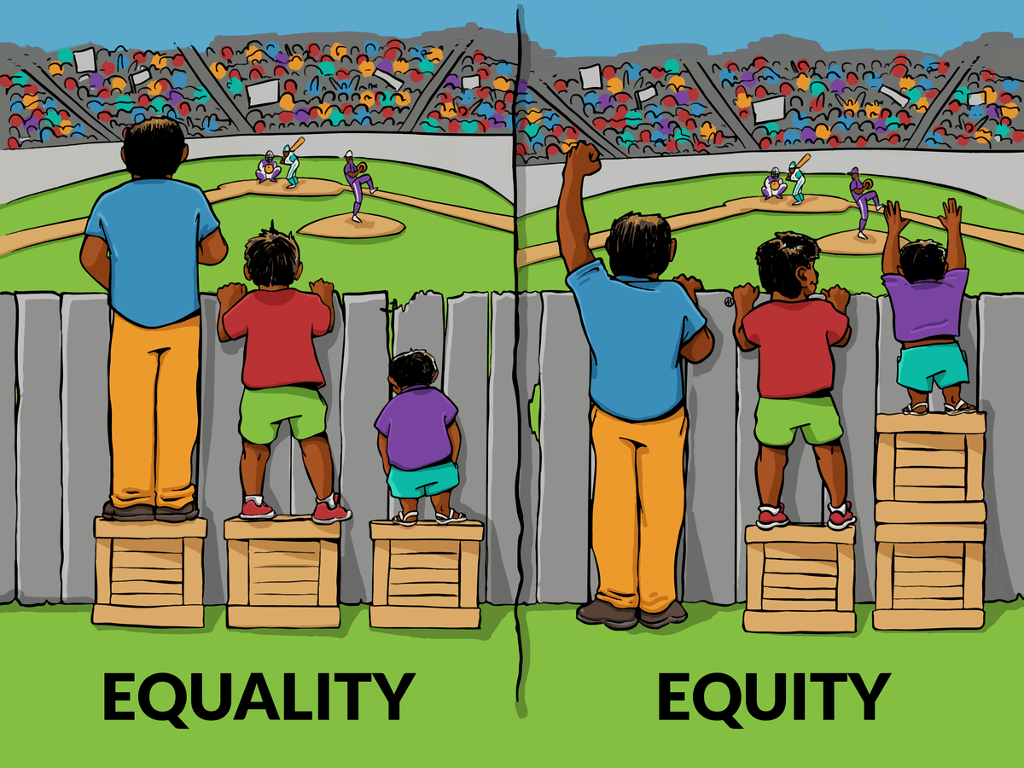
Accommodations and Modifications:
Each of our students will need some sort of accommodation or modification. As the student progresses these will change. If you feel that modifications and accommodations are not being carried out by the teacher please let me know via email. The teacher may have forgotten what is on the student’s IEP.
The image on the right is a visual of how accommodations help our students. Adding boxes or taking them away does not give anyone an unfair advantage, they merely help to make a level playing ground.

Slide 20
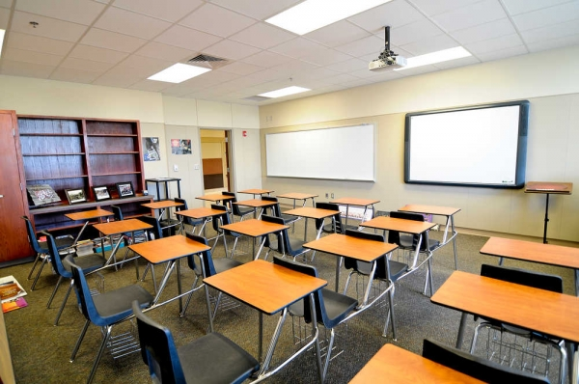
Behavior
When a student has poor behavior please remember that there might be multiple underlying factors: lack of sleep, family relation issues, lack of food, etc,.
-Redirect behavior back to the task at hand
-If a student has a behavior management plan follow up using the plan.
-Allow a short break
If the behavior continues notify me and we will discuss a plan of action.

Slide 21
Education
I value you and your skills and that’s why I want to support continuing your education. Below are books I have available for loaning. If your student is watching a movie in class, use that time to borrow one of my books!
Freaks, Geeks and Aspergers and Aspergers Syndrome: An Adolescent Guide
Smart but Scattered: The Revolutionary "Executive Skills" Approach to Helping Kids Reach Their Potential
Educational Psychology (Heavier reading but great stuff!)
If you have a desire to further your education please let me know, I would love to help get you going.

Slide 22
Lastly…..
Enjoy the students!
Ask for help
You are part of a team, communication is key!

Slide 23
Feel free to print any of these slides, or the whole document, for future reference.
We will quickly go over everything to make sure you do not have any questions and fully understand FERPA.
We are so glad to have you!
Diana Schroeder

